Slide 1
Multivariate Methods for Analytics MBAN 6400 Hemant Sangwan

Slide 2
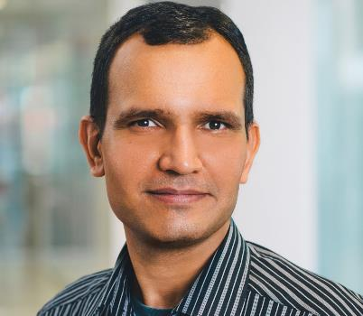
Hemant Sangwan
Full-time professor of Marketing, Seneca College, Toronto
Sessional lecturer for courses in data science, machine learning, marketing analytics, and marketing research
Master in Business Analytics program (MBAN), Schulich School of Business, York University
Schulich Executive Education Centre (SEEC)
School of Continuing Studies (SCS), York University
Rotman School of Management, University of Toronto
12+ years of industry experience in management consulting, data science & analytics, marketing research, economic consulting & forecasting
Independent Consultant (since 2019) and Expert advisor to a B2B startup in AI/Blockchain with focus on financial services (2020-21)
Previous employment: Boston Consulting Group, GfK Canada, IHS Markit
PhD in Management
(University of Toronto)
MS in Quantitative Economics (Indian Statistical Institute)

Slide 3
A little more about me…
Can engage in a lively discussion on
Setting up independent business – how/resources needed/key considerations
Challenges (and opportunities) of independent business/consulting
Data science and analytics in public policy
Financial literacy
Fun fact

Slide 4
The types of courses I teach
Marketing Fundamentals, Marketing Strategy, Marketing Research, Big Data and Marketing Analytics, Digital and Social Media Marketing
Multivariate Analytics, Analytics Capstone Project, Management Information System, Statistics
Case Presentation

Slide 5
Course Learning Outcomes (what this course is about)
Key topics include an overview of multivariate methods, partialling and statistical control, nominal and ordinal independent variables, experimental design, interaction effects and multi-group analyses, curvilinear and piecewise linear effects, discriminant and log-linear analysis, cluster analyses, multivariate regression, factor analysis – explanatory and confirmatory, ethics and privacy issues in multivariate analytics.
Identify high level patterns in the data and prepare data for subsequent analysis
Understand strengths, limitations, and challenges of multivariate analytics
Use specific method(s) to solve real world business problems (selecting the most appropriate method for a given data)
Interpret results from multivariate analysis. (data translation and story building, not just reading computer output!)

Slide 6
At the successful completion of this course…
…you should be able to
Help clients (or stakeholders) in framing and structuring multivariate analytics problems
Apply rigorous modeling to identify possible solutions
Track and measure performance of multivariate analytics models
Select the most appropriate plan of action for clients
Present solutions in form of a business presentation
Advise clients on their marketing initiatives using analytics and data driven approach

Slide 7
Course Structure (high level)
The course will be a combination of thinking, reading, analyzing, and solving marketing science and analytics challenges
conceptual discussion
applications of marketing analytics framework
cases and specific readings
2-way participation!
Students are expected to be prepared for each class by completing assigned readings, chapter from the textbook, and by actively participating in class discussion

Slide 8
Course Logistics
The course will run via Canvas. All course materials, communications, assignments, etc. will be posted on Quercus
All deliverables (e.g., assignments, project, etc.) need to be submitted on Canvas, i.e., no paper submission
When sending emails to me, please state course code (e.g. MBN6400) in the subject line

Slide 9
Evaluation Scheme
Work | Number | Weight | Due date
Individual
DataCamp modules |  | 15% | Ongoing (must be completed by w/o April 4th)
Term Test | 2 | 21% + 29% = 50% | w/o Feb 14th, w/o March 21st
Group
Group project – A (problem framing, preliminary analysis) | 1 | 10% | w/o Jan 31st
Group project – B (data modeling + final report) | 1 | 15% | w/o March 29th
Group project – Presentation | 1 | 5% | w/o March 29th
Group – Article / topic discussion | 1 | 5% | Ongoing

Slide 10
Course Materials
Prerequisite: Knowledge of statistics and probability, linear algebra at undergraduate level
Slides and supporting materials (e.g., cases, articles, videos, etc.) to be posted on Canvas
Laptop with Python/R installed!
Installation link. Retrieved from https://www.anaconda.com/products/individual
Anaconda Distribution Starter Guide. Retrieved from https://docs.anaconda.com/_downloads/9ee215ff15fde24bf01791d719084950/Anaconda-Starter-Guide.pdf
Getting anaconda. FAQs. Retrieved from https://docs.anaconda.com/anaconda/user-guide/faq/
Applied Multivariate Statistical Analysis, 6th Edition. Johnson and Wichern. Pearson. ISBN: 9780134995397
The Elements of Statistical Learnings. Trevor Hastie, Robert Tibshirani, Jerome Friedman. ISBN: 978-0-387-84857-0. Second Edition. Springer. A legal copy of the book is available for free download at http://web.stanford.edu/~hastie/ElemStatLearn/
Download link (Second Edition): https://web.stanford.edu/~hastie/ElemStatLearn/printings/ESLII_print12_toc.pdf

Slide 11
Why you should care about this course?
The course is built in such a way to provide you with hands-on experience in big data and marketing analytics
You will get an opportunity to design, plan, troubleshoot, and execute a comprehensive multivariate analytical modeling for the real world brands
You can add the project to your portfolio of work to enhance your professional profile
You can improve your skills in networking, teamwork, and presentation

Slide 12
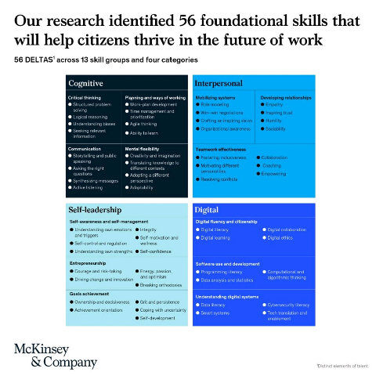
Skills you will need in the job market (may not be correlated with grades)
Presentation and communication
Financial literacy
Community involvement
Skills in making informed decisions
Business and Social skills
Professionalism
Remember:
Small things matter and can have big impact on your careers, e.g., respect for others time, working as a team
How do you want to position yourself?
Always on time, no unnecessary excuses, flexible and adaptable when working in a team OR Never on time, free rider, always take it easy approach

